Slide 1


Academy
Python Tooling 101
Anthony McKale Principal Engineer
19/08/2022

Slide 2
Python Tooling Basics
Today we’ll cover lots of python analysis tools
Tooling History
Static Analysis Tools
Dynamic Analysis Tools

Slide 3
Tooling History

Slide 4
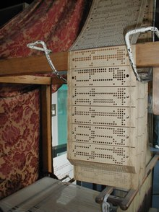
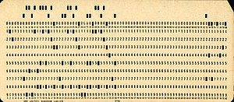
Tooling History
Once upon a time in the 1920s Code was written in punched 0 / 1s in paper
https://en.wikipedia.org/wiki/Punched_card

Slide 5
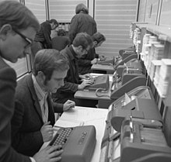
Tooling History
The paper code had mechanical problems…
The code failed to run as expected
because of these physical issues
Main villains of the punch-card
Computer era were Bugs and Lint
https://en.wikipedia.org/wiki/Punched_card

Slide 6
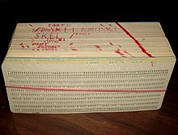
Tooling History: Bugs
Insects hid and ate the paper
So the first debugger was made* Manually looking over each page to literally remove and kill the paper-eating bugs…
Note *: the term has competing origin stories, I was told this personally by someone of the punch-card era
https://en.wikipedia.org/wiki/Bug_(engineering)
https://en.wikipedia.org/wiki/Computer_programming_in_the_punched_card_era

Slide 7
Tooling History: Linting
Paper punch-cards rubbed and gathered paper lint Small lint balls confused the optical sensors reading the punched holes So the first linter was made Sticky roller literally automatically removed the small paper lint balls…
https://en.wikipedia.org/wiki/Lint_(software)

Slide 8
Tooling History
These now have new meanings
Debugging - is now a manual process for actively finding logic issues
Linting - is now a automated process for passively finding confusing code
Also many other new tools have been made
https://en.wikipedia.org/wiki/Lint_(software)

Slide 9
Tooling History
We’ll be covering:
Static Analysis Tools - Code linting for confusing code
Static Fault Analysis
Dependency Analysis
Dynamic Analysis Tools
- Code Debugging for flaws not insects !
Unit testing (theory-only)
Integration Testing (theory-only)

Slide 10
Static Analysis

Slide 11
Static Analysis
Static Analysis tools run over your source code (normally via a IDE)
They find common programming mistakes and anti-patterns
These tools specialise into particular areas :
Best practice violations ( aka linters ☺ )
Security flaws (SAST)
Hard Coded Secrets (SAST)
Old / flawed library usage (SCA)
Common programming mistakes
Library misconfiguration

Slide 12
Static Analysis
Will go through these area’s tools
linters : Best practice violations
SAST : Security flaws
SCA : Old / flawed library usage

Slide 13
Linting

Slide 14
Linting
Linting is the automated process of making code less confusing
Linting normally auto formats code to a best practice standard
Best practice standards are normally subjective, e.g. Javascript
Due to Guido python has a single objective standard that’s pragmatically objective

Slide 15
Linting: Javascript
Javascript linting is dogmatic
“Lint will hurt your feelings.
Side effects may include headache, irritability, dizziness, snarkiness, stomach pain, defensiveness, dry mouth, cleaner code, and a reduced error rate.”
Aka follow the rules or else !
https://www.jslint.com/help.html

Slide 16
Linting: PEP8
Guido’s python programmatic objective standard “A Foolish Consistency is the Hobgoblin of Little Minds”
Code is read more than written
Improve the readability
make it consistent across the wide spectrum of Python code
know when to be inconsistent
When in doubt, use your best judgment
https://peps.python.org/pep-0008/

Slide 17
Linting: PEP8
Guido’s python objective standard
Covers:
Indentation
Import module order
Whitespace placement
String Constructors
Documentation
And more… !
https://peps.python.org/pep-0008/

Slide 18
Linting: PEP8
Three linting tools are: pylint – scans py code generating PEP8 compliance reports
https://pypi.org/project/pylint/
flake8 – similar to pylint, but less strict (configurable and less dogmatic) https://flake8.pycqa.org/en/latest/
Black – automated PEP8 formatter
https://black.readthedocs.io/en/stable/

Slide 19
Linting: PEP8
My favourate
Black – automated PEP8 formatter
https://black.readthedocs.io/en/stable/ Run with:
pip install black black .

Slide 20
Linting
Questions ?

Slide 21
SAST
Static Analysis [Security] Testing

Slide 22
SAST
Static Analysis tools run over your source code (normally via a IDE)
They find common programming mistakes and anti-patterns
Security flaws (SAST)
Hardcoded Secrets (SAST)
Common programming mistakes
Library misconfiguration
Hard coded Passwords

Slide 23
SAST
House Security 101: don’t left your keys in the lock
Software Security 101: don’t put passwords in source code*
Unfortunately, it’s a common anti-security pattern to do so
Even if it’s one commit and the commit is overwritten it’s there forever
* All sensitive information including credentials and passwords should be securely stored at REST (when not being actively used)

Slide 24
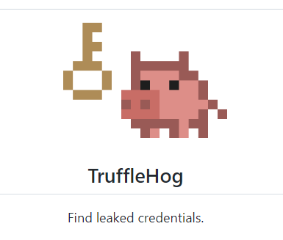
Trufflehog v3
Popular hard-coded secrets finder SAST tool
Can search GITHUB history
Or local file system Quick Run with: docker run -it -v "$PWD:/pwd" trufflesecurity/trufflehog:latest git file://. --json Lots more options here: https://github.com/trufflesecurity/truffleHog

Slide 25
Semgrep
security flaws (SAST) tool semgrep is the leading multi-language opensource solution Finds library misconfiguration, poor programming practices, etc Also Github’s codeQL is also excellent but very expensive
How to run: docker run --rm -v "${PWD}:/src" returntocorp/semgrep semgrep --config=auto
https://semgrep.dev/docs/getting-started/

Slide 26
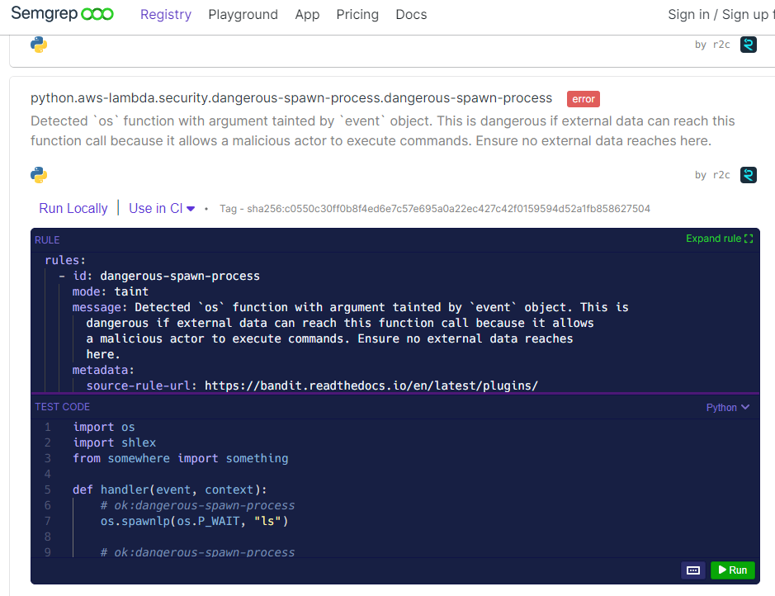
Static Analysis Security Testing
https://semgrep.dev/p/python

Slide 27
Static Analysis Security Testing
Questions on SAST ?

Slide 28
SCA
Software Composition Analysis

Slide 29
Software Composition Analysis
Modern software is built on Libraries
Libraries are built on top of one-another
Libraries have flaws:
some by mistake
some by design
some maliciously
https://snyk.io/series/open-source-security/software-composition-analysis-sca/

Slide 30
Software Composition Analysis
Modern applications and libraries are registered with CVE
Vulnerabilities are assigned a CVE number when flaws are found
These vulnerabilities can be searched by name and version of the software https://cve.mitre.org/

Slide 31
Software Composition Analysis
SCA tools statically scan manifest files These contain the list of libraries used by the application
They download the information of any nested libraries as well, created a Software Bill of Materials (SBOM)
The SBOM is checked against the CVE database https://cve.mitre.org/

Slide 32
Software Composition Analysis
Pip-audit is a excellent Python SCA tool How to run:
python -m pip install pip-audit pip-audit -r ./requirements.txt
https://pypi.org/project/pip-audit/

Slide 33
Software Composition Analysis
Questions on SCA ?

Slide 34
Dynamic Analysis

Slide 35
Dynamic Analysis
Dynamic Analysis tools run with your code (normally via a IDE)
They execute scenarios and analyse output to finds programming mistakes and flaws
Some specialised into a particular area :
Helping manual analysis (Debuggers)
Automating input/expected output scenarios ( Unit Testing )
End to End / System to System testing ( Integration Testing )

Slide 36
Dynamic Analysis
Will go through these area’s tools
Debuggers : Helping manual analysis
Unit Testing : Automating input/expected output scenarios
Integration Testing : End to End / System to System testing

Slide 37
Debugging/ Debuggers

Slide 38
Debugging
Debugging is the manual process of step by step walking through code lines, to find flaws in logic
These flaws are called bugs
You can debug by hand or via tools

Slide 39
Debugging: Common bugs / flaws
Logic Errors like +/- 1, or plain mistakes in steps
Racetime conditions runtime state logic errors
Complication Errors type confusion errors
Integration Errors Dependency or library assumption issues

Slide 40
Debugging with Debuggers
Debuggers aid programmers by allowing running code to be stopped and inspected
Typical Inspections:
Variables can be viewed and changed
Functions can be ran
Pause/play code line by line

Slide 41
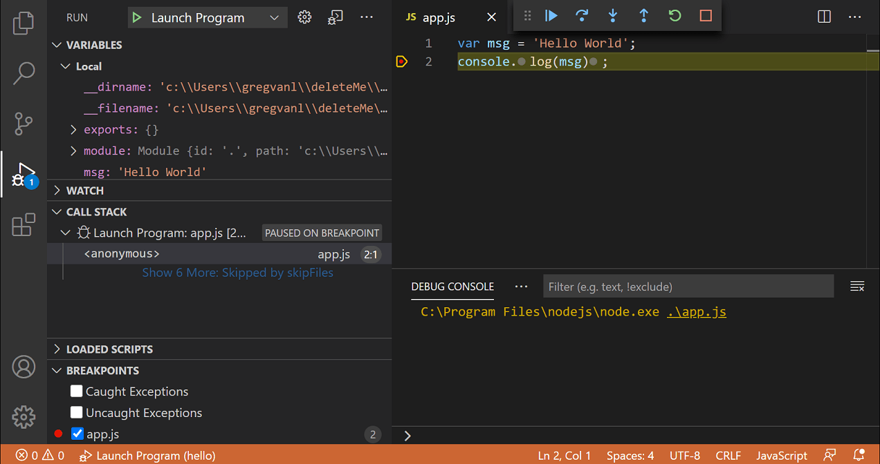
Debugging
Debuggers are embedded into modern IDEs
major draw for using IDEs over simpler text editors
VSCode docs
https://code.visualstudio.com/docs/editor/debugging

Slide 42
Debugging
Questions ?

Slide 43
Automated Testing aka Unit / Integration

Slide 44
Automated Testing
Automated Testing tests code with known inputs, and expected outputs
Unit Tests test individual functions, ensure the correct output is returned for a given input
Integration Tests test the overall application, and ensure it gives the correct outputs, when interacting with external environment

Slide 45
Automated Testing
Real code is ran in isolation (unit testing) or as a full applications (integration testing)
This allows developers to dynamically verify the applications output given preset inputs
For Functions and CLI applications, language interpreters are used to insert input, and capture output
For Web/UI applications, full browsers are used to insert keyboard and mouse commands, and screen capture is used for output

Slide 46
Automated Testing: Caveats
Of course there are caveats to the “full end to end” testing
When testing unpredictable or hard to manage dependencies are often swapped out for mock implementations E.g. replacing a complex production database with a static json fixture file pretending to be a database
Also code can be annotated with spys and instrumentation, for metadata such as number of calls or number of lines executed can be collected

Slide 47
Automated Testing
Automated Testing tests code are not free
Automated Testing is not* automatically created, only automatically run
Automated Testing is such a big topic, it’s for the next and final section
* Rarely automatically created

Slide 48
Automated Testing
Questions ?

Slide 49
Questions
I’ve been Anthony M^{c}Kale “Wizard without Portfolio” Fixer-Upper of Broken things, and creator of time-constrained workable Fudges for 21 years. Email : anthony@zapper.hodgers.com

Slide 50
Thank
you

